Slide 1



Course: Data Mining
Bachelor Study Programme: Computer Science and Technology
Lesson 1:
Data presentation.
Data classification
Ass. prof. E. Pinevich

Slide 2
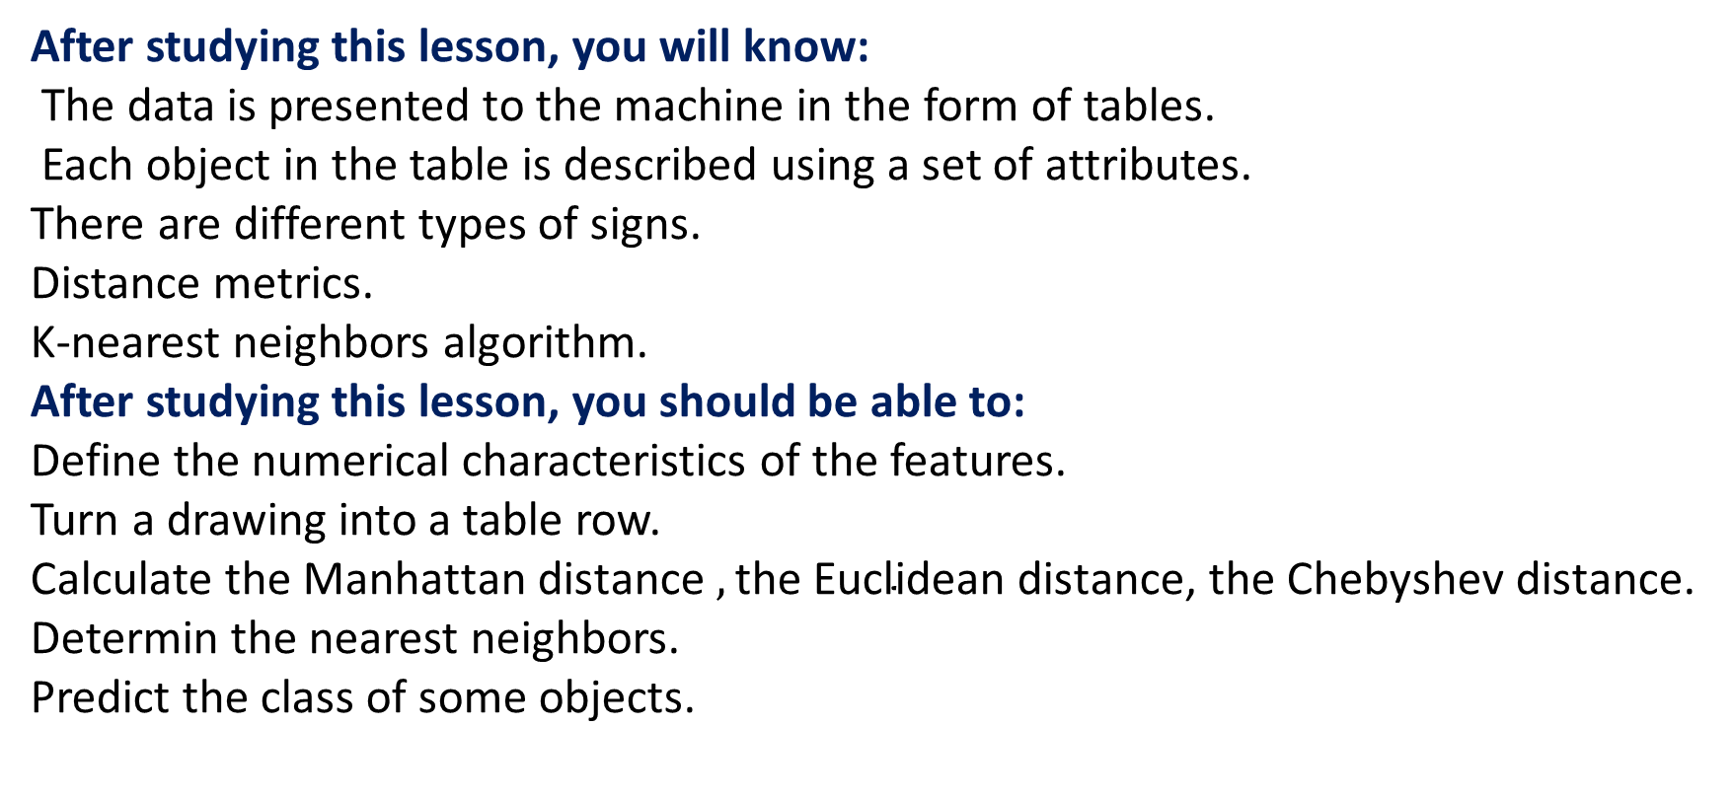
Learning Objectives
After studying this lesson, you will know:
The data is presented to the machine in the form of tables.
Each object in the table is described using a set of attributes.
There are different types of signs.
Distance metrics.
K-nearest neighbors algorithm.
After studying this lesson, you should be able to:
Define the numerical characteristics of the features.
Turn a drawing into a table row.
Calculate the $\text{Manhattan} \text{d}\text{istance} ,\text{the} \text{Euclidean} \text{distance}\text{, }\text{the} \text{Chebyshev} \text{distance}\text{.}$
Determin the nearest neighbors.
Predict the class of some objects.

Slide 3
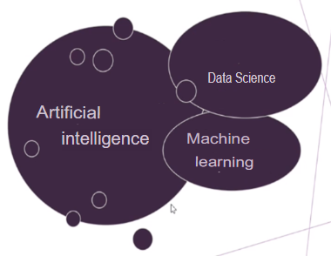
DATA MINING
Let's consider the science of collecting, storing and processing data arrays, analyzing large amounts of data using all kinds of mathematical methods, including machine learning.
Data mining is the process of detecting and extracting patterns in large datasets, including methods at the interface of machine learning, statistics, and database systems.

Slide 4
ISSUE 1: In what form is the data supplied
to the machine?
Objects\Facilities | Feature 1 | Feature 2 | ….. | Feature m
A1 | P11 | P12 | …. | P1m
A2 | P21 | P22 | …. | P2m
…. | … | … | …. | …
An | Pn1 | Pn2 | …. | Pnm
There are n objects here, each of which has m features.
Using P(A), we will denote the value of the attribute P for the object A.
The number n is called the sample size.
Notes:
For example, it is an architectural design issue whether a computer will have
a multiply instruction. It is an organizational issue whether that instruction will be
implemented by a special multiply unit or by a mechanism that makes repeated
use of the add unit of the system. The organizational decision may be based on the
anticipated frequency of use of the multiply instruction, the relative speed of the
two approaches, and the cost and physical size of a special multiply unit
Many computer manufacturers offer a family of computer models, all with the same architecture but with differences in organization.
In a class of computers called microcomputers, the relationship between
architecture and organization is very close. Changes in technology not only influence organization but also result in the introduction of more powerful and more
complex architectures. Generally, there is less of a requirement for generation to-generation compatibility for these smaller machines.

Slide 5
Types of signs
Quantitative (numeric) - the attribute of its values is real numbers and the attribute itself has a numerical nature.
Ordinal- the attribute sets the order on the objects.
Nominal (categorical) - a feature has no numerical nature and, as a rule, the number of its possible values is finite.
In particular, a binary attribute is a nominal attribute with 2 possible values.
Notes:
8080: The world’s first general- purpose microprocessor. This was an 8-bit
machine, with an 8-bit data path to memory. The 8080 was used in the first
personal computer, the Altair.
8086: A far more powerful, 16-bit machine. In addition to a wider data path and larger registers, the 8086 sported an instruction cache, or queue, that prefetches a few instructions before they are executed.
80486: The 80486 introduced the use of much more sophisticated and powerful cache technology and sophisticated instruction pipelining. The 80486 also offered a built-in math coprocessor, offloading complex math operations from the main CPU.
Pentium: With the Pentium, Intel introduced the use of superscalar techniques, which allow multiple instructions to execute in parallel.
Pentium Pro: The Pentium Pro continued the move into superscalar organization begun with the Pentium, with aggressive use of register renaming, branch
prediction, data flow analysis, and speculative execution.
Pentium II: The Pentium II incorporated Intel MMX technology, which is designed specifically to process video, audio, and graphics data efficiently.

Slide 6
Example
Student | Gender | Height | Weight | Blood type | Place at the Olympics
Ivanov | 1 | 175 | 70 | 2 | 3
Petrov | 1 | 180 | 75 | 3 | 1
Sidorova | 0 | 160 | 55 | 1 | 2
Smirnova | 0 | 172 | 65 | 4 | 4
Height and weight are real numbers (a quantitative attribute).
Gender is a binary attribute.
Blood type is a nominal (but not binary) trait.
A place at the Olympics is an ordinal sign.
Notes:
In general terms, there are only four basic functions that a computer can perform.

Slide 7
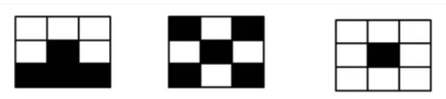
How to present a set of images in the form of a table?
• Let's say there are black and white drawings consisting of 9 pixels.
•We number the pixels. We get 9 binary signs.
Notes:
There are four main structural components
■ Control unit: Controls the operation of the CPU and hence the computer.
■ Arithmetic and logic unit (ALU): Performs the computer’s data processing functions.
■ Registers: Provides storage internal to the CPU.
■ CPU interconnection: Some mechanism that provides for communication among the control unit, ALU, and registers.
In recent years, there has been increasing use of multiple processors in a single computer. Some design issues relating to multiple processors crop up

Slide 8
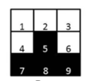
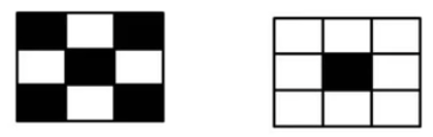
Turning a drawing into a table row
Drawing | P1 | P2 | P3 | P4 | P5 | P6 | P7 | P8 | P9
Drawing 1 | 0 | 0 | 0 | 0 | 1 | 0 | 1 | 1 | 1
Drawing 2 | 1 | 0 | 1 | 0 | 1 | 0 | 1 | 0 | 1
Drawing 3 | 0 | 0 | 0 | 0 | 1 | 0 | 0 | 0 | 0
Notes:
Computers generally have multiple processors.
When these processors all reside on a single chip, the term multicore computer is used, and each processing unit (consisting of a control unit, ALU, registers, and perhaps cache) is called a core. To clarify the terminology, this text will use the following definitions.
The main printed circuit board in a computer is called a system board or motherboard
The motherboard contains a slot or socket for the processor chip, which typically contains multiple individual cores, in what is known as a multicore processor.
A chip is a single piece of semiconducting material, typically silicon, upon which electronic circuits and logic gates are fabricated. The resulting product is referred to as an integrated circuit.
Another prominent feature of contemporary computers is the use of multiple layers of memory, called cache memory, between the processor and main memory.
Next, we zoom in on the structure of a single core, which occupies a portion of the processor chip. In general terms, the functional elements of a core are:
■ Instruction logic: This includes the tasks involved in fetching instructions, and decoding each instruction to determine the instruction operation and the memory locations of any operands.
■ Arithmetic and logic unit (ALU): Performs the operation specified by an instruction.
■ Load/store logic: Manages the transfer of data to and from main memory via cache.

Slide 9
An important limitation
All objects must have the same number of attributes so that they can be entered into one table.
Fulfilling this requirement is not always easy:
• If object A has a more complex structure (or a richer history) than B.
•If objects A and B are pictures, then they must have the same format and size.
Notes:
The first generation of computers used vacuum tubes for digital logic elements and memory. A number of research and then commercial computers were built using vacuum tubes. For our purposes, it will be instructive to examine perhaps the most
famous first-generation computer, known as the IAS computer. This example illustrates many of the fundamental concepts found in all computer systems.
A fundamental design approach first implemented in the IAS computer is known as the stored-program concept. This idea is usually attributed to the mathematician John von Neumann.
Alan Turing developed the idea at about the same time.
The first publication of the idea was in a 1945 proposal by von Neumann for a new computer, the EDVAC (Electronic Discrete Variable Computer).
In 1946, von Neumann and his colleagues began the design of a new stored program computer, referred to as the IAS computer, at the Princeton Institute for
Advanced Studies. The IAS computer, although not completed until 1952, is the prototype of all subsequent general-purpose computers.
Since the device is primarily a computer, it will have to perform the elementary operations of arithmetic most frequently. These are addition, subtraction, multiplication, and division.
■ Memory buffer register (MBR): Contains a word to be stored in memory or sent
to the I/O unit, or is used to receive a word from memory or from the I/O unit.
■ Memory address register (MAR): Specifies the address in memory of the word
to be written from or read into the MBR.
■ Instruction register (IR): Contains the 8-bit opcode instruction being executed.
■ Instruction buffer register (IBR): Employed to hold temporarily the righthand instruction from a word in memory.
■ Program counter (PC): Contains the address of the next instruction pair to be fetched from memory.
■ Accumulator (AC) and multiplier quotient (MQ): Employed to hold temporarily operands and results of ALU operations. For example, the result of multiplying two 40-bit numbers is an 80-bit number

Slide 10
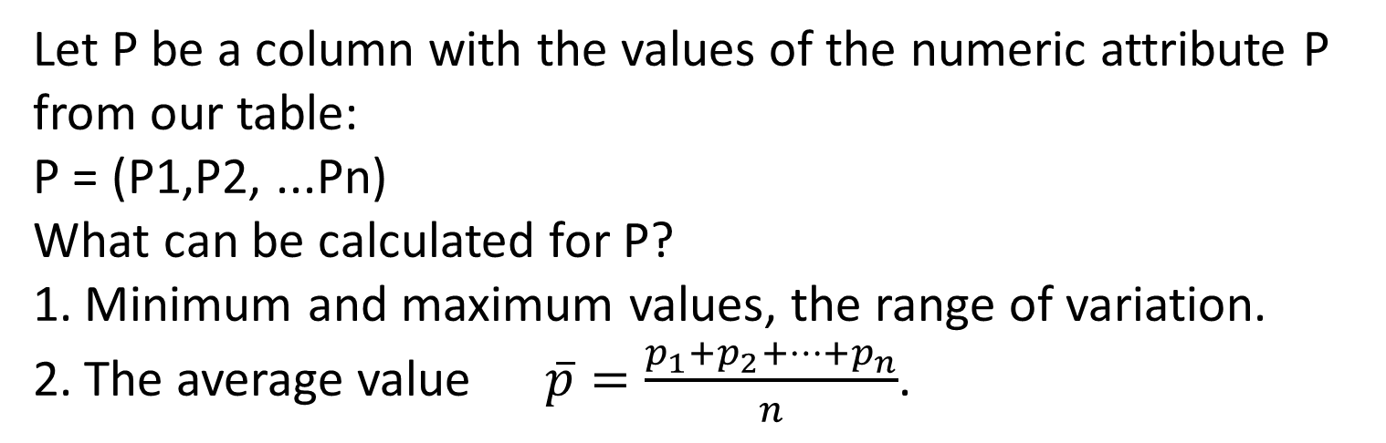
ISSUE 2: Basic concepts of mathematical statistics
What characteristics do the signs have?
Let P be a column with the values of the numeric attribute P from our table:
P = (P1,P2, ...Pn)
What can be calculated for P?
Minimum and maximum values, the range of variation.
The average value $\overline{p}=\frac{p_{1}+p_{2}+…+p_{n}}{n}$.
Notes:
Moore observed that the number of transistors that could be
put on a single chip was doubling every year, and correctly predicted that this pace
would continue into the near future.
3. The computer becomes smaller, making it more convenient to place in a variety of environments.
4. There is a reduction in power requirements.
5. The interconnections on the integrated circuit are much more reliable than
solder connections. With more circuitry on each chip, there are fewer interchip connections.

Slide 11
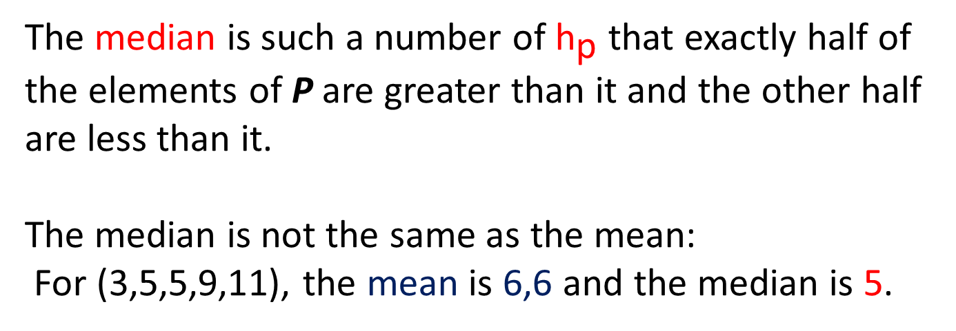
Numerical characteristics of the signs
The median is such a number of ${\text{h}}_{\text{p}}$ that exactly half of the elements of Р are greater than it and the other half are less than it.
The median is not the same as the mean:
For (3,5,5,9,11), the mean is 6,6 and the median is 5.
Notes:
Pentium III: The Pentium III incorporates additional floating- point instructions: The Streaming SIMD Extensions (SSE) instruction set extension added 70 new instructions
Core: This is the first Intel x86 microprocessor with a dual core, referring to the implementation of two cores on a single chip
Core 2: The Core 2 extends the Core architecture to 64 bits.
Core i9 :
Core i9 is a family of high-performance and high core count 64-bit x86 microprocessors introduced by Intel in mid-2017

Slide 12
CALCULATING THE MEDIAN
For samples of even volume, the median is not uniquely determined. Where is the median: (1,3,4,5)?
In practice, the arithmetic mean between the two "central" values is taken as the median.
In the example above, the median is (3+4)/2=3.5
Tip: to quickly calculate the median, you need to mentally arrange the array in ascending order and take a number from the middle.
If the median and the mean are close to each other, then the sample is called symmetric. It is easier to look for anomalies in a symmetrical sample.
Notes:
ARM is a family of RISC-based microprocessors and microcontrollers designed by ARM Holdings, Cambridge, England.
CORTEX-A: These processors run at higher clock frequency (over 1 GHz), and support a memory management unit (MMU), which is required for full feature OSs such as Linux, Android, MS Windows, and mobile Oss
■ Cortex-M0: Designed for 8- and 16-bit applications, this model emphasizes low cost, ultra low power, and simplicity. It is optimized for small silicon die size (starting from 12k gates) and use in the lowest cost chips. ■ Cortex-M0+: An enhanced version of the M0 that is more energy efficient.
■ Cortex- M3: Designed for 16- and 32-bit applications, this model emphasizes performance and energy efficiency. It also has comprehensive debug and trace features to enable software developers to develop their applications quickly.
■ Cortex-M4: This model provides all the features of the Cortex-M3, with additional instructions to support digital signal processing tasks.
■ Cortex-M7: Provides higher performance than the M4. It is still primarily a 32-bit machine but uses 64-bit wide instruction and data buses.
■ Cortex-M23: This model is similar to the M0+, and adds integer divide instructions and some security features.
■ Cortex-M33: This model is similar to the M4, and adds some security features.

Slide 13
Fashion
Fashion is the value that occurs most frequently in the sample.
For example, the fashion here (2,0,1,1,3,2,3,2) would be 2.
Fashion is not always unambiguously defined.
!!! Fashion (unlike the average and median) makes sense for nominal features as well.
Notes:
■ NVIC: Provides configurable interrupt handling abilities to the processor. It
facilitates low- latency exception and interrupt handling, and controls power
management.
■ ETM: An optional debug component that enables reconstruction of program
execution. The ETM is designed to be a high- speed, low- power debug tool
that only supports instruction trace.
■ Debug access port (DAP): This provides an interface for external debug
access to the processor.
■ Debug logic: Basic debug functionality includes processor halt, single- step,
processor core register access, unlimited software breakpoints, and full system
memory access.
■ ICode interface: Fetches instructions from the code memory space.
■ SRAM & peripheral interface: Read/write interface to data memory and
peripheral devices.
■ Bus matrix: Connects the core and debug interfaces to external buses on the
microcontroller.
■ Memory protection unit: Protects critical data used by the operating system
from user applications, separating processing tasks by disallowing access
to each other’s data, disabling access to memory regions, allowing memory
regions to be defined as read-only, and detecting unexpected memory accesses
that could potentially break the system.

Slide 14
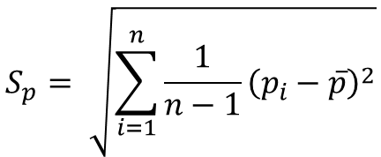
Deviation
The mean and median are not sufficient to adequately describe the sample.
For example, the samples (0,0,0,0,0) and (-2,-1,0,1,2) have the same averages and medians. However, in the second sample, the values more often deviate from the average. The deviation (full name: mean square deviation) is calculated using the formula:
$$S_{p}= \sqrt{\sum_{i=1}^{n}{{\frac{1}{n−1}\left(p_{i}−\overline{p}\right)}^{2}}}$$

Slide 15
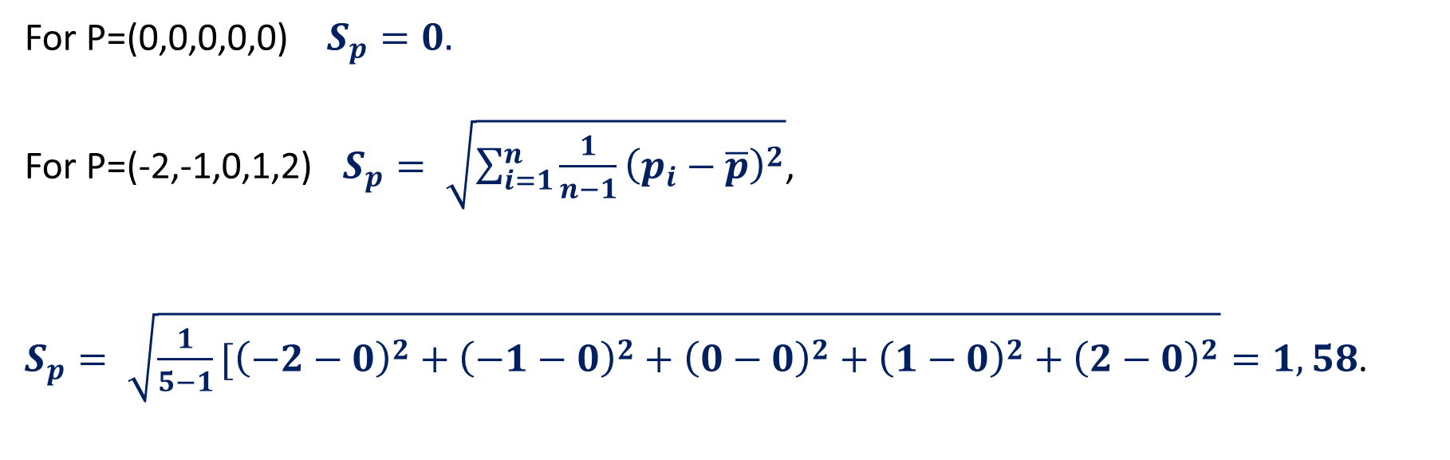
Example
For Р=(0,0,0,0,0) $S_{p}=0.$
For Р=(-2,-1,0,1,2) $S_{p}= \sqrt{\sum_{i=1}^{n}{{\frac{1}{n−1}\left(p_{i}−\overline{p}\right)}^{2}}}$,
$S_{p}= \sqrt{{\frac{1}{5−1}[\left(−2−0\right)}^{2}+{\left(−1−0\right)}^{2}+{\left(0−0\right)}^{2}+{\left(1−0\right)}^{2}+{\left(2−0\right)}^{2}}=1,58$.

Slide 16
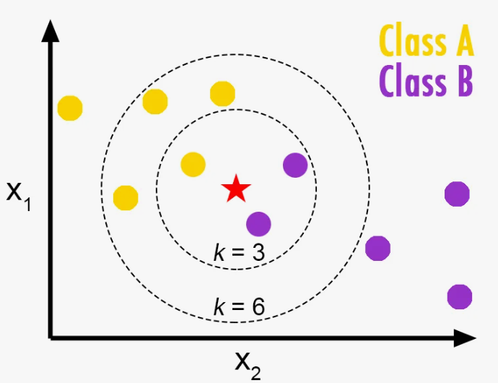
ISSUE 3: K-nearest neighbors.
General concepts
The K-Nearest Neighbors (KNN) algorithm is one of the simplest and most understandable machine learning algorithm used to solve classification problems.
The basic idea of KNN is to predict the class of an object based on the class of its nearest neighbors.
Notes:
A microcontroller chip makes a substantially different use of the logic space available. Microcontrollers are heavily utilized in automation processes.
Another typical feature of a microcontroller is that it does not provide for human interaction. The microcontroller is programmed for a specific task, embedded in its device, and executes as and when required.
A microcontroller is a single chip that contains the processor,
non-volatile memory for the program (ROM), volatile memory for input and output
(RAM), a clock, and an I/O control unit
The processor portion of the microcontroller has a much lower silicon area than other microprocessors and much higher energy efficiency.

Slide 17
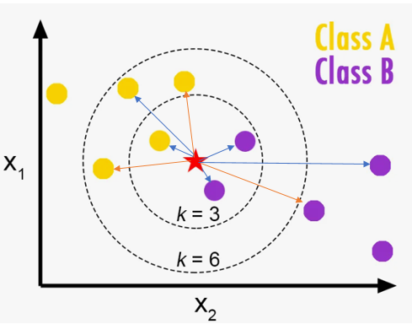
Determining the nearest neighbors
KNN is a metric classification method, that is, objects are represented as points in space and distances between them are calculated.
Therefore, the signs should be normalized (reduced to the same scale).

Slide 18
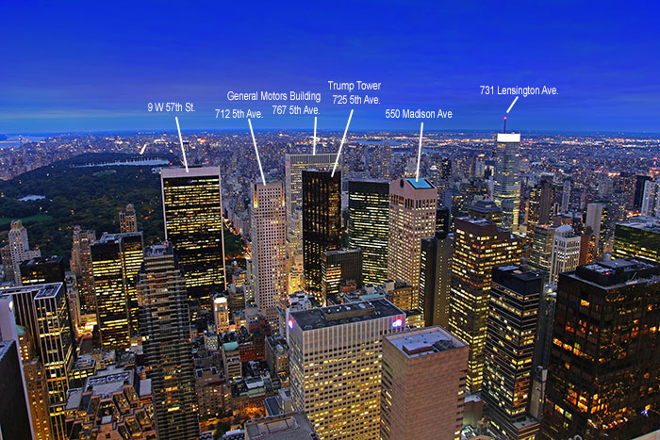
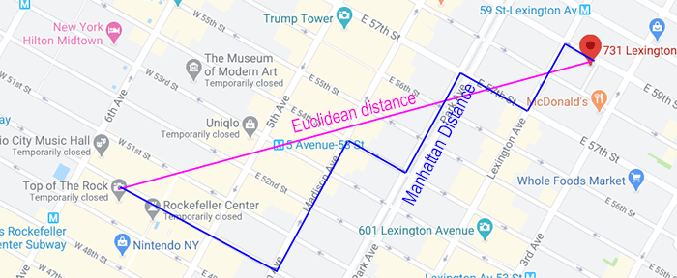
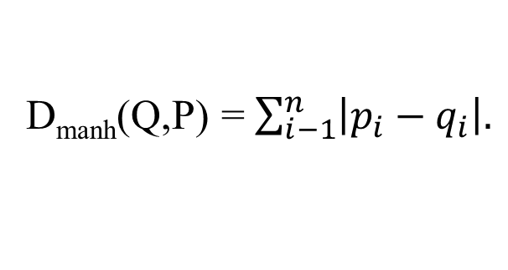
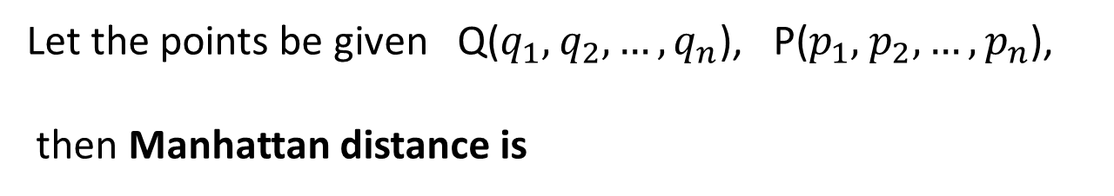
ISSUE 4: Distance metrics
The Manhattan Distance
(distance of city blocks)
Let the points be given Q($q_{1},$ $q_{2},…,q_{n}$), P($p_{1},$ $p_{2},…,p_{n}$),
then Manhattan distance is
D_{manh}(Q,P) = $\sum_{i−1}^{n}{\left|p_{i}−q_{i}\right|.}$

Slide 19
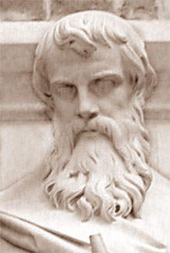
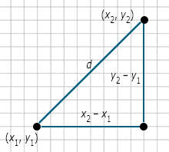

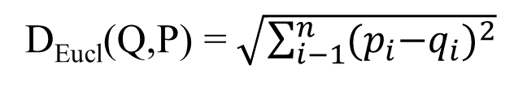
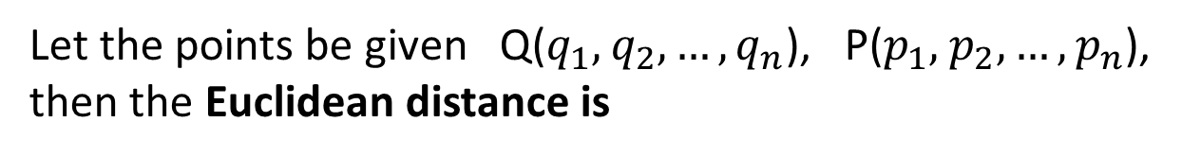
The Euclidean distance
The Euclidean distance between two points is a straight line connecting these points.
To determine the distance in two-dimensional space you can use the Pythagorean theorem. For points p and q with coordinates (x₁, y₁) and (x₂, y₂) in two-dimensional space (on the plane) the Euclidean distance is determined by the formula:
Let the points be given Q($q_{1},$ $q_{2},…,q_{n}$), P($p_{1},$ $p_{2},…,p_{n}$), then the Euclidean distance is
D_{Eucl}(Q,P) = $\sqrt{\sum_{i−1}^{n}{{{(p}_{i}−q_{i})}^{2}}}$

Slide 20
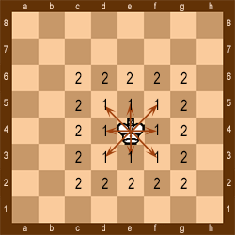
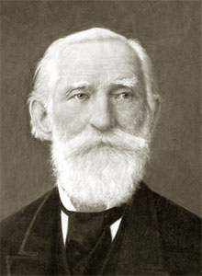
The Chebyshev Distance
(the chessboard metric)
What is the minimum number of steps a king must take to move from one square of the board to another?
K2
K1
1
2
3
4
5
6
7
8
Let the points be given Q($q_{1},$ $q_{2},…,q_{n}$), P($p_{1},$ $p_{2},…,p_{n}$), then the Chebyshev distance is:
Let the king want to move from point K1(5;1) to point K2(8;2), then the Chebyshev distance
is: D(K1,K2)=max{∣$8−5$∣,∣$2−1$∣}= max {(3,1)} = 3.
Notes:
The integrated circuit exploits the fact that such components as transistors, resistors, and conductors can be fabricated from a semiconductor such as silicon. It is merely an extension of the solid-state art to fabricate an entire circuit in a tiny piece of silicon rather than assemble discrete components made from separate pieces of silicon into the same circuit. Many transistors can be produced at the same time on a single wafer of silicon. Equally important, these transistors can be connected with a process of metallization to form circuits.
A thin wafer of silicon is divided into a matrix of small areas, each a few millimeters square. The identical circuit pattern is fabricated in each area, and the wafer is broken up into chips. Each chip consists of many gates and/or memory cells plus a number of input and output attachment points

Slide 21
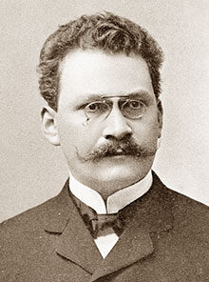

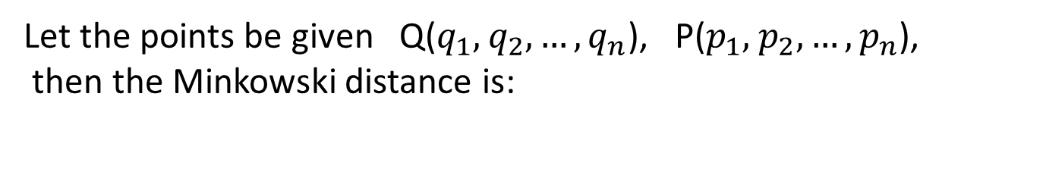
The Minkowski distance
Let the points be given Q($q_{1},$ $q_{2},…,q_{n}$), P($p_{1},$ $p_{2},…,p_{n}$),
then the Minkowski distance is:
where λ is the order of the Minkowski metric.
For different values of λ, the Minkowski distance is calculated in three ways:
• λ = 1 — Manhattan distance (metric L1)
• λ = 2 — Euclidean distance (metric L2)
• λ = ∞ — Chebyshev distance (metric L∞)
Notes:
Computers generally have multiple processors.
When these processors all reside on a single chip, the term multicore computer is used, and each processing unit (consisting of a control unit, ALU, registers, and perhaps cache) is called a core. To clarify the terminology, this text will use the following definitions.
The main printed circuit board in a computer is called a system board or motherboard
The motherboard contains a slot or socket for the processor chip, which typically contains multiple individual cores, in what is known as a multicore processor.
A chip is a single piece of semiconducting material, typically silicon, upon which electronic circuits and logic gates are fabricated. The resulting product is referred to as an integrated circuit.
Another prominent feature of contemporary computers is the use of multiple layers of memory, called cache memory, between the processor and main memory.
Next, we zoom in on the structure of a single core, which occupies a portion of the processor chip. In general terms, the functional elements of a core are:
■ Instruction logic: This includes the tasks involved in fetching instructions, and decoding each instruction to determine the instruction operation and the memory locations of any operands.
■ Arithmetic and logic unit (ALU): Performs the operation specified by an instruction.
■ Load/store logic: Manages the transfer of data to and from main memory via cache.

Slide 22
ISSUE 5: K-nearest neighbors algorithm
The table shows the values of height and weight of people and the groups to which person belong depending on weight and height.
Determine which group the F person with a height of 157 cm and a weight of 54 kg belongs to.
Let's calculate the Manhattan distance from point F(157,54) to points:
Person | Height | Weight | Target
A | 150 | 50 | Medium
B | 155 | 55 | Medium
C | 160 | 60 | Large
D | 161 | 59 | Large
E | 158 | 65 | Large
F | 157 | 54 | ?
A(150,50); B(155;55); C(160,60); D(161;59); E(158,65)
Notes:
For example, it is an architectural design issue whether a computer will have
a multiply instruction. It is an organizational issue whether that instruction will be
implemented by a special multiply unit or by a mechanism that makes repeated
use of the add unit of the system. The organizational decision may be based on the
anticipated frequency of use of the multiply instruction, the relative speed of the
two approaches, and the cost and physical size of a special multiply unit
Many computer manufacturers offer a family of computer models, all with the same architecture but with differences in organization.
In a class of computers called microcomputers, the relationship between
architecture and organization is very close. Changes in technology not only influence organization but also result in the introduction of more powerful and more
complex architectures. Generally, there is less of a requirement for generation to-generation compatibility for these smaller machines.

Slide 23
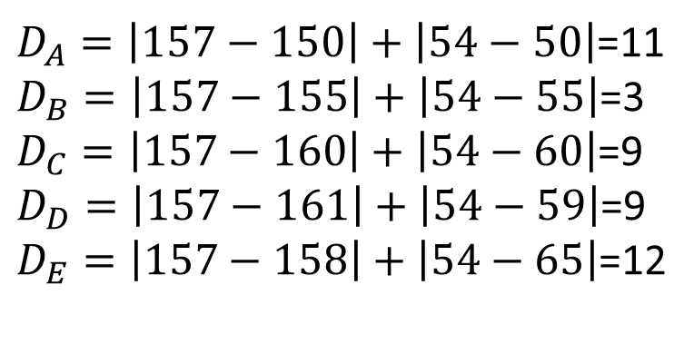
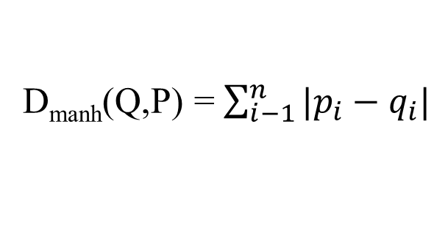

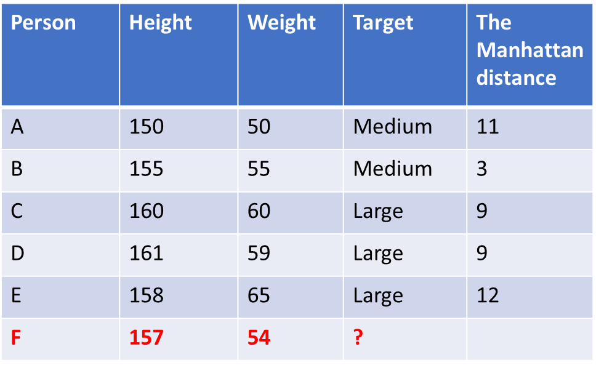

Metric $L_{1}(\text{The} \text{Manhattan} \text{d}\text{istance}$)
D_{manh}(Q,P) = $\sum_{i−1}^{n}{|p_{i}−q_{i}|}$
Person | Height | Weight | Target | The $\text{Manhattan}$ distance
A | 150 | 50 | Medium | 11
B | 155 | 55 | Medium | 3
C | 160 | 60 | Large | 9
D | 161 | 59 | Large | 9
E | 158 | 65 | Large | 12
F | 157 | 54 | ?
For our task, the formula will take the following form:
$$D_{Manh}=\left|x_{2}−x_{1}\right|+\left|y_{2}−y_{1}\right|$$
$D_{A}=\left|157−150\right|+\left|54−50\right|$=11
$D_{B}=\left|157−155\right|+\left|54−55\right|$=3
$D_{C}=\left|157−160\right|+\left|54−60\right|$=9
$D_{D}=\left|157−161\right|+\left|54−59\right|$=9
$D_{E}=\left|157−158\right|+\left|54−65\right|$=12
Notes:
The first generation of computers used vacuum tubes for digital logic elements and memory. A number of research and then commercial computers were built using vacuum tubes. For our purposes, it will be instructive to examine perhaps the most
famous first-generation computer, known as the IAS computer. This example illustrates many of the fundamental concepts found in all computer systems.
A fundamental design approach first implemented in the IAS computer is known as the stored-program concept. This idea is usually attributed to the mathematician John von Neumann.
Alan Turing developed the idea at about the same time.
The first publication of the idea was in a 1945 proposal by von Neumann for a new computer, the EDVAC (Electronic Discrete Variable Computer).
In 1946, von Neumann and his colleagues began the design of a new stored program computer, referred to as the IAS computer, at the Princeton Institute for
Advanced Studies. The IAS computer, although not completed until 1952, is the prototype of all subsequent general-purpose computers.
Since the device is primarily a computer, it will have to perform the elementary operations of arithmetic most frequently. These are addition, subtraction, multiplication, and division.
■ Memory buffer register (MBR): Contains a word to be stored in memory or sent
to the I/O unit, or is used to receive a word from memory or from the I/O unit.
■ Memory address register (MAR): Specifies the address in memory of the word
to be written from or read into the MBR.
■ Instruction register (IR): Contains the 8-bit opcode instruction being executed.
■ Instruction buffer register (IBR): Employed to hold temporarily the righthand instruction from a word in memory.
■ Program counter (PC): Contains the address of the next instruction pair to be fetched from memory.
■ Accumulator (AC) and multiplier quotient (MQ): Employed to hold temporarily operands and results of ALU operations. For example, the result of multiplying two 40-bit numbers is an 80-bit number

Slide 24
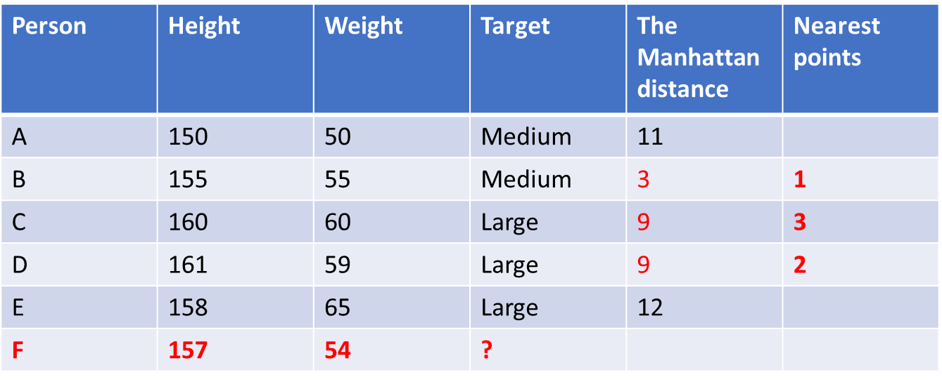
K=3
Person | Height | Weight | Target | The $\text{Manhattan}$ distance | Nearest points
A | 150 | 50 | Medium | 11
B | 155 | 55 | Medium | 3 | 1
C | 160 | 60 | Large | 9 | 3
D | 161 | 59 | Large | 9 | 2
E | 158 | 65 | Large | 12
F | 157 | 54 | ?
Therefore, a person F belongs to group «Large»
Notes:
Moore observed that the number of transistors that could be
put on a single chip was doubling every year, and correctly predicted that this pace
would continue into the near future.
3. The computer becomes smaller, making it more convenient to place in a variety of environments.
4. There is a reduction in power requirements.
5. The interconnections on the integrated circuit are much more reliable than
solder connections. With more circuitry on each chip, there are fewer interchip connections.

Slide 25
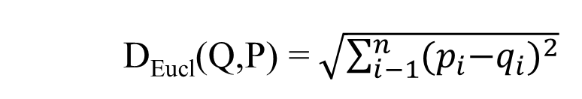
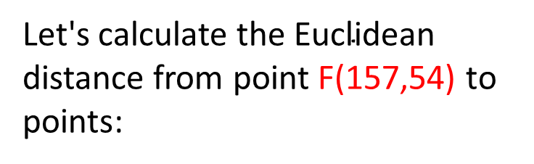
Metric $L_{2 }(\text{The} \text{Euclidean} \text{d}\text{istance}$)
D_{Eucl}(Q,P) = $\sqrt{\sum_{i−1}^{n}{{{(p}_{i}−q_{i})}^{2}}}$
Person | Height | Weight | Target
A | 150 | 50 | Medium
B | 155 | 55 | Medium
C | 160 | 60 | Large
D | 161 | 59 | Large
E | 158 | 65 | Large
F | 157 | 54 | ?
Let's calculate the $\text{Euclidean}$ distance from point F(157,54) to points:
A(150,50); B(155;55); C(160,60);
D(161;59); E(158,65).
Notes:
Moore observed that the number of transistors that could be
put on a single chip was doubling every year, and correctly predicted that this pace
would continue into the near future.
3. The computer becomes smaller, making it more convenient to place in a variety of environments.
4. There is a reduction in power requirements.
5. The interconnections on the integrated circuit are much more reliable than
solder connections. With more circuitry on each chip, there are fewer interchip connections.

Slide 26

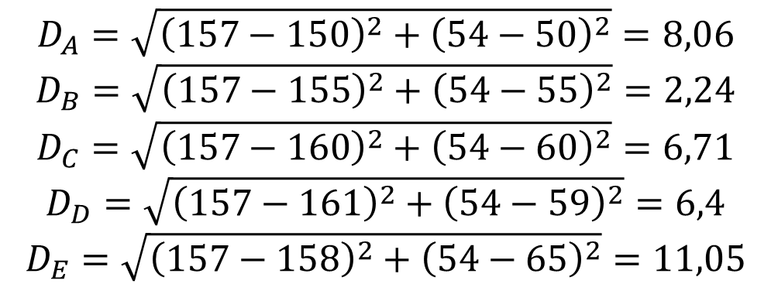

Metric $L_{2 }(\text{The} \text{Euclidean} \text{d}\text{istance}$)
For our task, the formula will take the following form:
$$D_{Eucl}=\sqrt{{\left(x_{2}−x_{1}\right)}^{2}+{\left(y_{2}−y_{1}\right)}^{2}}$$
Person | Height | Weight | Target | The Euclidean distance
A | 150 | 50 | Medium | 8,06
B | 155 | 55 | Medium | 2,24
C | 160 | 60 | Large | 6,71
D | 161 | 59 | Large | 6,4
E | 158 | 65 | Large | 11,05
F | 157 | 54 | ?
$$D_{A}=\sqrt{{\left(157−150\right)}^{2}+{\left(54−50\right)}^{2}}=8,06$$
$$D_{B}=\sqrt{{\left(157−155\right)}^{2}+{\left(54−55\right)}^{2}}=2,24$$
$$D_{C}=\sqrt{{\left(157−160\right)}^{2}+{\left(54−60\right)}^{2}}=6,71$$
$$D_{D}=\sqrt{{\left(157−161\right)}^{2}+{\left(54−59\right)}^{2}}=6,4$$
$$D_{E}=\sqrt{{\left(157−158\right)}^{2}+{\left(54−65\right)}^{2}}=11,05$$
Notes:
The first generation of computers used vacuum tubes for digital logic elements and memory. A number of research and then commercial computers were built using vacuum tubes. For our purposes, it will be instructive to examine perhaps the most
famous first-generation computer, known as the IAS computer. This example illustrates many of the fundamental concepts found in all computer systems.
A fundamental design approach first implemented in the IAS computer is known as the stored-program concept. This idea is usually attributed to the mathematician John von Neumann.
Alan Turing developed the idea at about the same time.
The first publication of the idea was in a 1945 proposal by von Neumann for a new computer, the EDVAC (Electronic Discrete Variable Computer).
In 1946, von Neumann and his colleagues began the design of a new stored program computer, referred to as the IAS computer, at the Princeton Institute for
Advanced Studies. The IAS computer, although not completed until 1952, is the prototype of all subsequent general-purpose computers.
Since the device is primarily a computer, it will have to perform the elementary operations of arithmetic most frequently. These are addition, subtraction, multiplication, and division.
■ Memory buffer register (MBR): Contains a word to be stored in memory or sent
to the I/O unit, or is used to receive a word from memory or from the I/O unit.
■ Memory address register (MAR): Specifies the address in memory of the word
to be written from or read into the MBR.
■ Instruction register (IR): Contains the 8-bit opcode instruction being executed.
■ Instruction buffer register (IBR): Employed to hold temporarily the righthand instruction from a word in memory.
■ Program counter (PC): Contains the address of the next instruction pair to be fetched from memory.
■ Accumulator (AC) and multiplier quotient (MQ): Employed to hold temporarily operands and results of ALU operations. For example, the result of multiplying two 40-bit numbers is an 80-bit number

Slide 27
K=3
Person | Height | Weight | Target | The Euclidean distance | Nearest points
A | 150 | 50 | Medium | 8,06
B | 155 | 55 | Medium | 2,24 | 1
C | 160 | 60 | Large | 6,71 | 3
D | 161 | 59 | Large | 6,4 | 2
E | 158 | 65 | Large | 11,05
F | 157 | 54 | ?
Therefore, a person F belongs to group «Large».
Notes:
Moore observed that the number of transistors that could be
put on a single chip was doubling every year, and correctly predicted that this pace
would continue into the near future.
3. The computer becomes smaller, making it more convenient to place in a variety of environments.
4. There is a reduction in power requirements.
5. The interconnections on the integrated circuit are much more reliable than
solder connections. With more circuitry on each chip, there are fewer interchip connections.

Slide 28
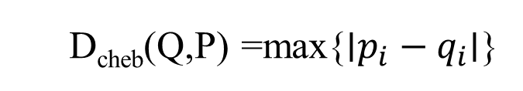
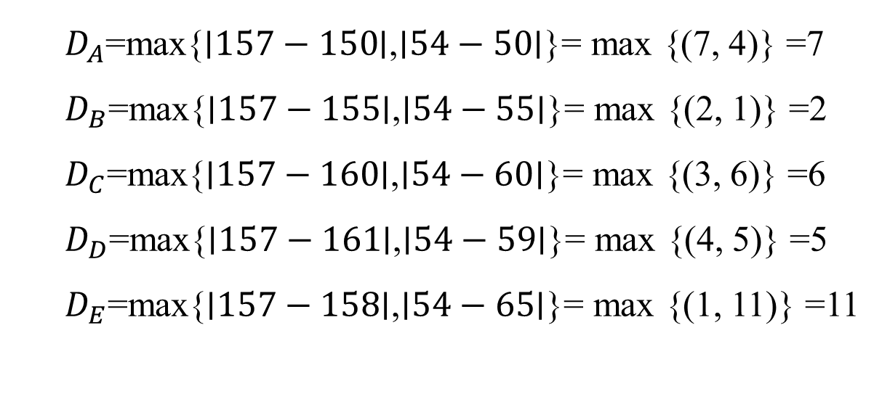
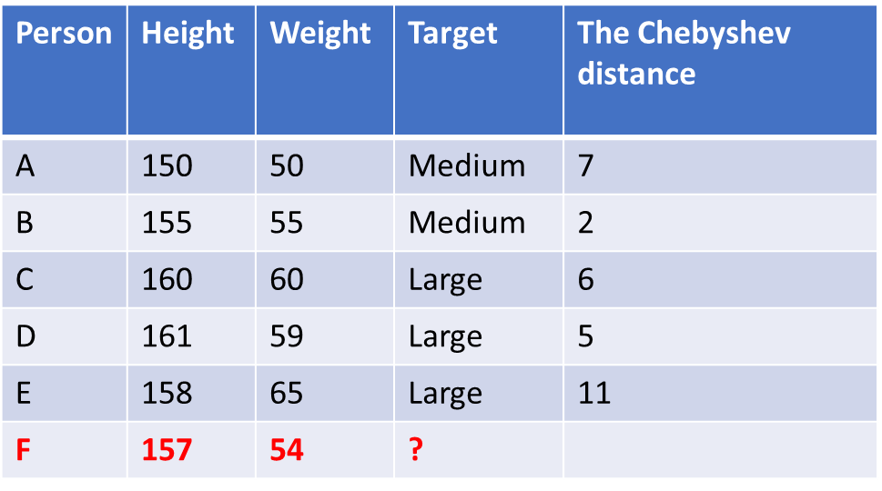

Metric $L_{\text{∞}}$
$(\text{The} \text{Chebyshev} \text{d}\text{istance}$)
Person | Height | Weight | Target | The $\text{Chebyshev}$ distance
A | 150 | 50 | Medium | 7
B | 155 | 55 | Medium | 2
C | 160 | 60 | Large | 6
D | 161 | 59 | Large | 5
E | 158 | 65 | Large | 11
F | 157 | 54 | ?
D_{cheb}(Q,P) =max{∣$p_{i}−q_{i}$∣}
$D_{A}$=max{∣$157−150$∣,∣$54−50$∣}= max {(7, 4)} =7
$D_{B}$=max{∣$157−155$∣,∣$54−55$∣}= max {(2, 1)} =2
$D_{C}$=max{∣$157−160$∣,∣$54−60$∣}= max {(3, 6)} =6
$D_{D}$=max{∣$157−161$∣,∣$54−59$∣}= max {(4, 5)} =5
$D_{E}$=max{∣$157−158$∣,∣$54−65$∣}= max {(1, 11)} =11
Notes:
The first generation of computers used vacuum tubes for digital logic elements and memory. A number of research and then commercial computers were built using vacuum tubes. For our purposes, it will be instructive to examine perhaps the most
famous first-generation computer, known as the IAS computer. This example illustrates many of the fundamental concepts found in all computer systems.
A fundamental design approach first implemented in the IAS computer is known as the stored-program concept. This idea is usually attributed to the mathematician John von Neumann.
Alan Turing developed the idea at about the same time.
The first publication of the idea was in a 1945 proposal by von Neumann for a new computer, the EDVAC (Electronic Discrete Variable Computer).
In 1946, von Neumann and his colleagues began the design of a new stored program computer, referred to as the IAS computer, at the Princeton Institute for
Advanced Studies. The IAS computer, although not completed until 1952, is the prototype of all subsequent general-purpose computers.
Since the device is primarily a computer, it will have to perform the elementary operations of arithmetic most frequently. These are addition, subtraction, multiplication, and division.
■ Memory buffer register (MBR): Contains a word to be stored in memory or sent
to the I/O unit, or is used to receive a word from memory or from the I/O unit.
■ Memory address register (MAR): Specifies the address in memory of the word
to be written from or read into the MBR.
■ Instruction register (IR): Contains the 8-bit opcode instruction being executed.
■ Instruction buffer register (IBR): Employed to hold temporarily the righthand instruction from a word in memory.
■ Program counter (PC): Contains the address of the next instruction pair to be fetched from memory.
■ Accumulator (AC) and multiplier quotient (MQ): Employed to hold temporarily operands and results of ALU operations. For example, the result of multiplying two 40-bit numbers is an 80-bit number

Slide 29
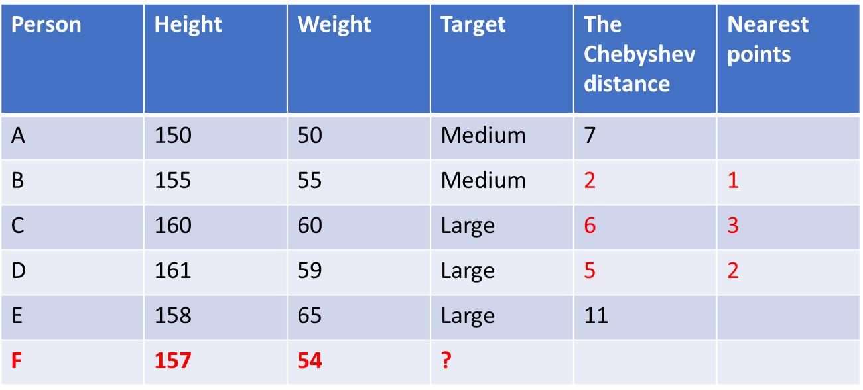
K=3
Person | Height | Weight | Target | The $\text{Chebyshev}$ distance | Nearest points
A | 150 | 50 | Medium | 7
B | 155 | 55 | Medium | 2 | 1
C | 160 | 60 | Large | 6 | 3
D | 161 | 59 | Large | 5 | 2
E | 158 | 65 | Large | 11
F | 157 | 54 | ?
Therefore, a person F belongs to group «Large».
Notes:
Moore observed that the number of transistors that could be
put on a single chip was doubling every year, and correctly predicted that this pace
would continue into the near future.
3. The computer becomes smaller, making it more convenient to place in a variety of environments.
4. There is a reduction in power requirements.
5. The interconnections on the integrated circuit are much more reliable than
solder connections. With more circuitry on each chip, there are fewer interchip connections.

Slide 30
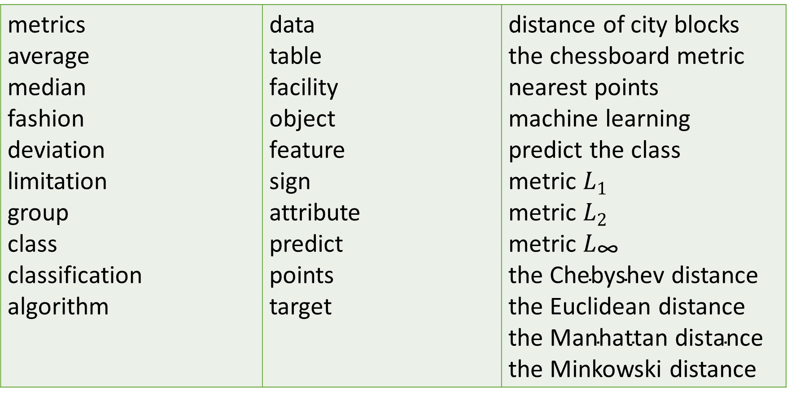
Key Terms
metrics average median fashion deviation limitation group class classification algorithm | data table facility object feature sign attribute predict points target | distance of city blocks the chessboard metric nearest points machine learning predict the class metric $L_{1}$ metric $L_{2 }$ metric $L_{\text{∞}}$ the $\text{Chebyshev}$ distance the Euclidean distance the $\text{Manhattan} \text{d}\text{istance}$ the Minkowski distance
Notes:
Today we have studied the following concepts
In the next lecture, we will repeat these concepts. You should explain their meaning in a few words. Everyone understands this ?
Until the next lecture

